Slide 1

Remote Databases in Mobile App Development
Remote databases power apps that update instantly across all your devices. They're crucial for modern mobile development, enabling cloud-based data storage and real-time synchronization.

Slide 2

What is a Remote Database?
Cloud-Based
Multi-User Access
Essential For
Hosted on servers rather than local devices. Accessible from anywhere.
Multiple users can access the same data from different devices or locations.
Real-time synchronization, large-scale data storage, and collaborative features.

Slide 3











Popular Remote Database Options
Amazon DynamoDB
Firebase Solutions
AWS-powered NoSQL database
Firestore and Realtime Database
MongoDB Atlas
Cloud-based MongoDB solution
Other Solutions
Azure Cosmos DB
Realm, Couchbase, Supabase
Microsoft's globally distributed database

Slide 4





Firebase Firestore
Document-Based Structure
Perfect for Chat Apps
Stores data in documents and collections.
Each message stored as a document within a collection.
Ideal for Social Media
Real-Time Updates
Efficiently stores profiles, posts, and comments.
Changes appear instantly for all users.

Slide 5
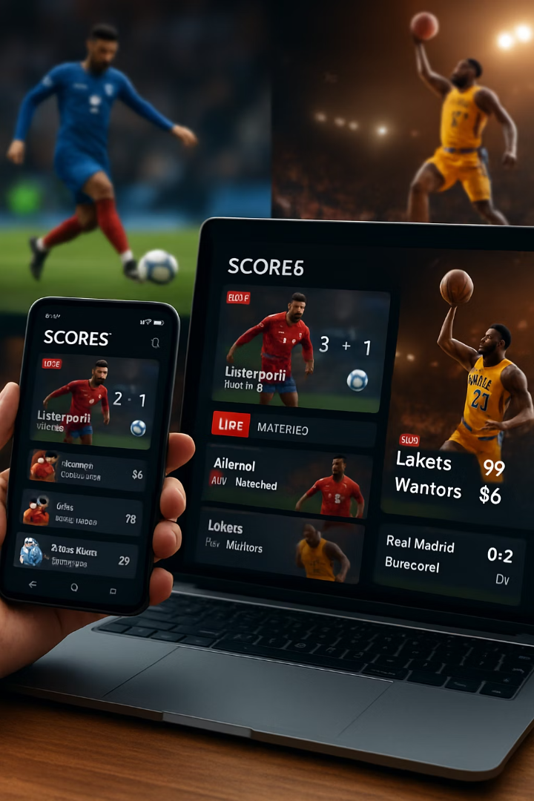



Firebase Realtime Database
JSON Tree Structure
Stores data as a single JSON tree.
Fast Updates
Ideal for applications requiring rapid data changes.
Sports App Example
Handles live score updates with immediate visibility.

Slide 6
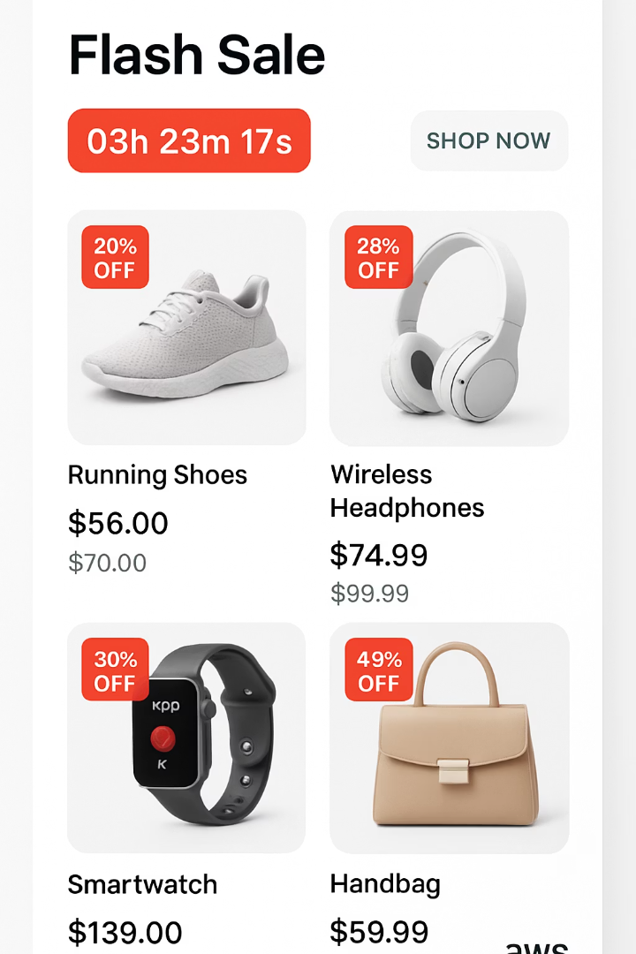




Amazon DynamoDB
AWS-Powered NoSQL
Fully managed database service with predictable performance.
Table Organization
Data organized into tables with items and attributes.
Seamless Scalability
Handles high-traffic applications with ease.
E-Commerce Example
Efficiently manages product info and user sessions during traffic spikes.

Slide 7






MongoDB Atlas
Cloud-Based MongoDB
Popular database in the cloud
Rich Queries & Indexing
Complex data handling capabilities
Flexible Schema
Store diverse data types easily
Perfect for travel planning apps that manage user itineraries and preferences with personalized data structures.

Slide 8
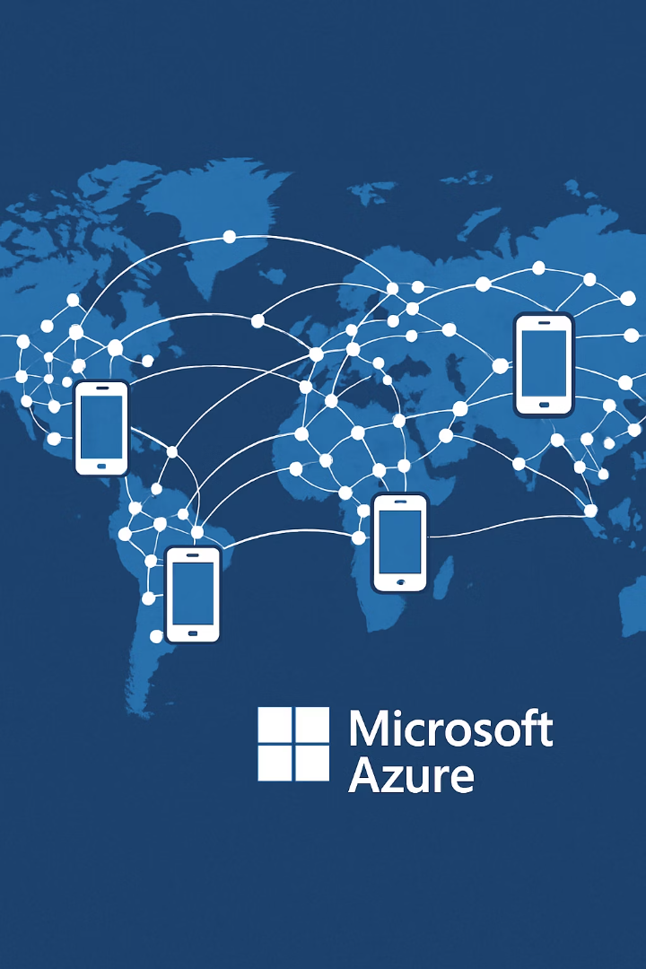



Microsoft Azure Cosmos DB
Globally Distributed
Fast data access regardless of user location.
Multiple Data Models
Supports various NoSQL approaches.
News App Example
Stores articles and comments across regions for fast access.

Slide 9
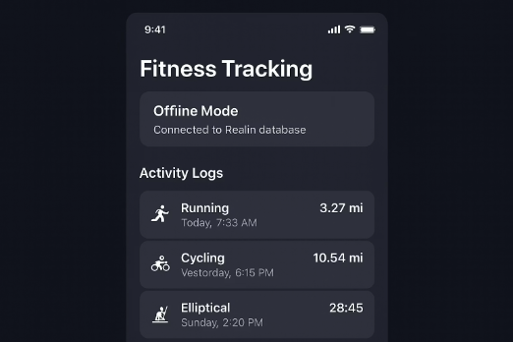
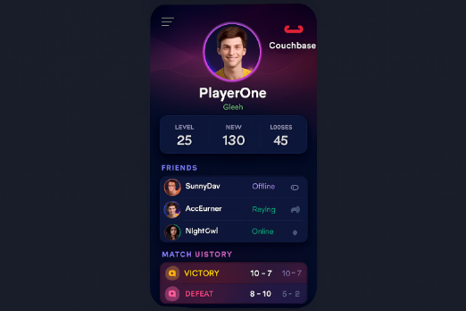
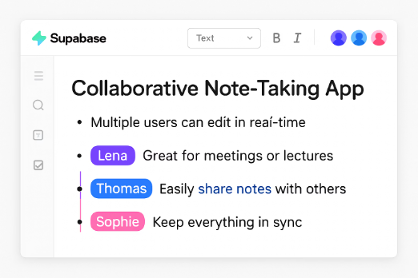
Realm, Couchbase & Supabase
Realm
Couchbase
Supabase
Mobile-specific database with local storage and cloud sync. Perfect for fitness apps that work offline.
Combines document database with key-value store. Ideal for gaming apps needing quick data access.
Open-source Firebase alternative with PostgreSQL and real-time features. Great for collaborative apps.

Slide 10

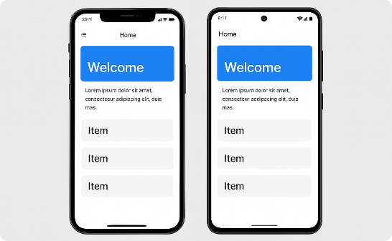

Advantages: Accessibility
Global Access
Multi-Platform
Collaboration
Users interact with data from anywhere, on any device.
Applications work seamlessly across iOS, Android, and web.
Multiple users can work simultaneously on the same data.

Slide 11



Advantages: Performance & Security
Real-Time Synchronization
Users see updates immediately without manual refreshes
Automatic Scaling
Accommodates increased traffic during high-demand periods
Enhanced Security
Encryption, access controls, and automated backups

Slide 12

Disadvantages: Connectivity & Cost
Internet Dependency
Requires stable connection. Poor connectivity leads to slow performance or unavailability.
Latency affects user experience
Server location impacts speed
Cost Considerations
Subscription models can become expensive as applications scale.
Hidden fees for data transfer or storage
Unexpected cost increases

Slide 13








Disadvantages: Complexity & Lock-in
Learning Curve
Data Consistency
Challenging for developers new to cloud technologies
Ensuring consistency across distributed systems is difficult
Provider Instability
Vendor Lock-in
Applications impacted by provider outages
Relying on specific providers limits flexibility

Slide 14

Choosing the Right Database
Firebase Firestore
Real-time apps, social media, chat
Firebase Realtime
Fast updates, sports scores, simple data
DynamoDB
High-traffic, e-commerce, scalability needs
MongoDB Atlas
Complex queries, flexible schema requirements
Cosmos DB
Global distribution, multi-region apps
Realm
Offline-first mobile apps, fitness tracking
Couchbase
Fast access, gaming, performance-critical
Supabase
Collaborative apps, SQL preference

Slide 15

Key Takeaways
8+
4
Database Options
Key Advantages
Major remote database solutions available for mobile development
Accessibility, real-time sync, scalability, security
4
Challenges
Connectivity, cost, complexity, vendor lock-in

